Slide 1
POV, HMW,
Experience Prototypes
Assignment 2
Grace Miller, Ginelle Servat, CJ Indart, Riley Pittman

Slide 2
Agenda
Revised Project Domain
Additional Needfinding
POVs | HMWs
Solutions & Experience Prototypes
What’s Next?
Appendix

Slide 3
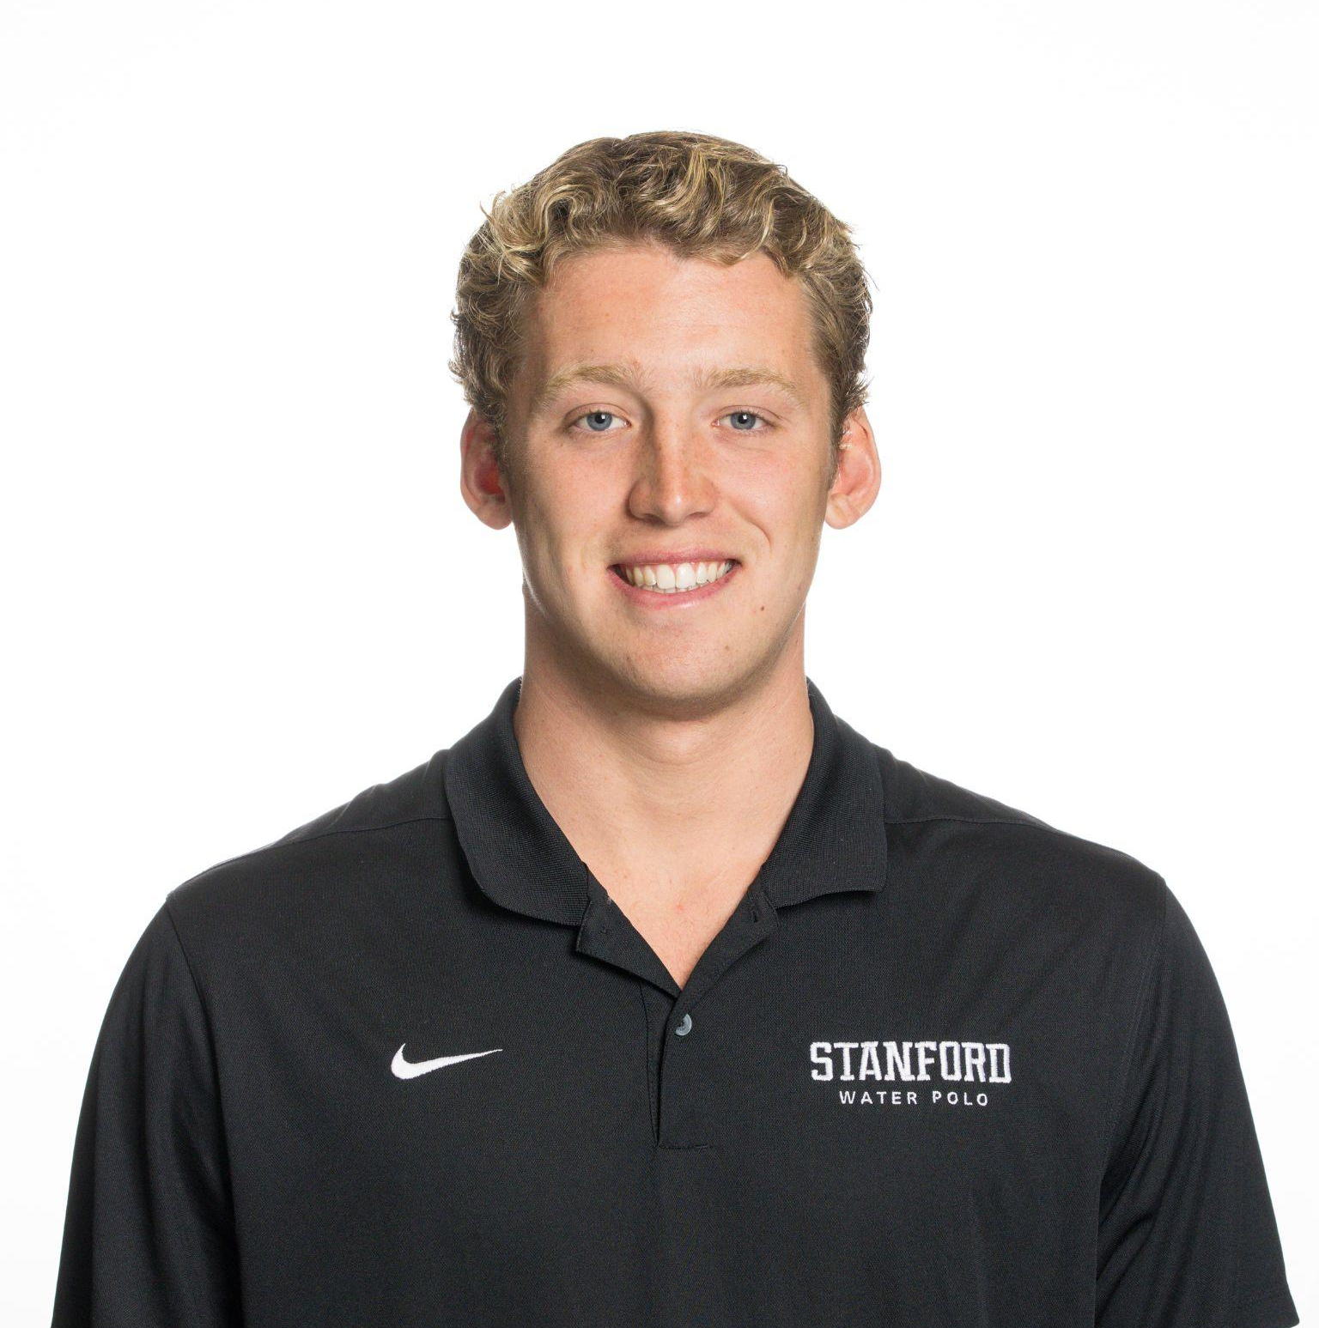
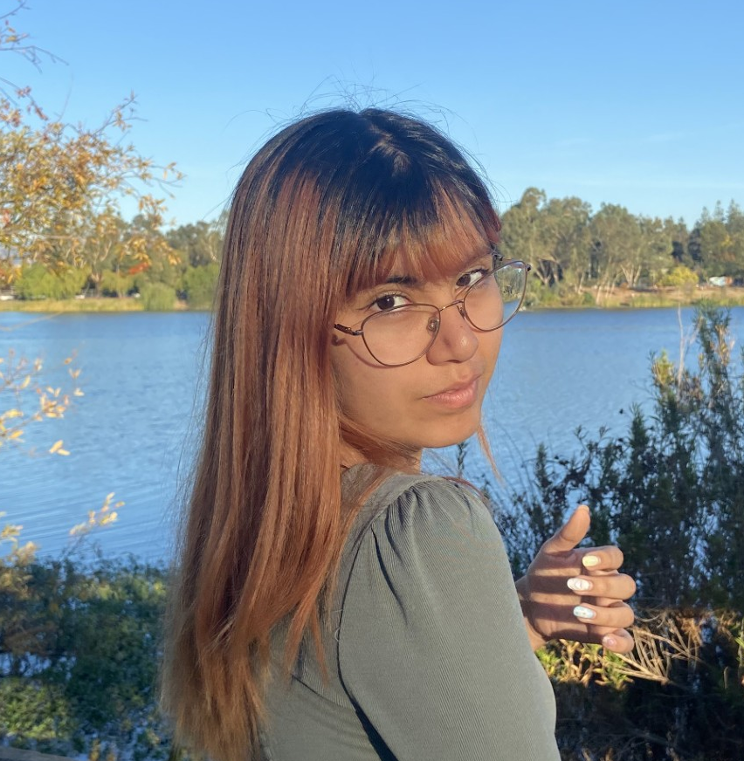
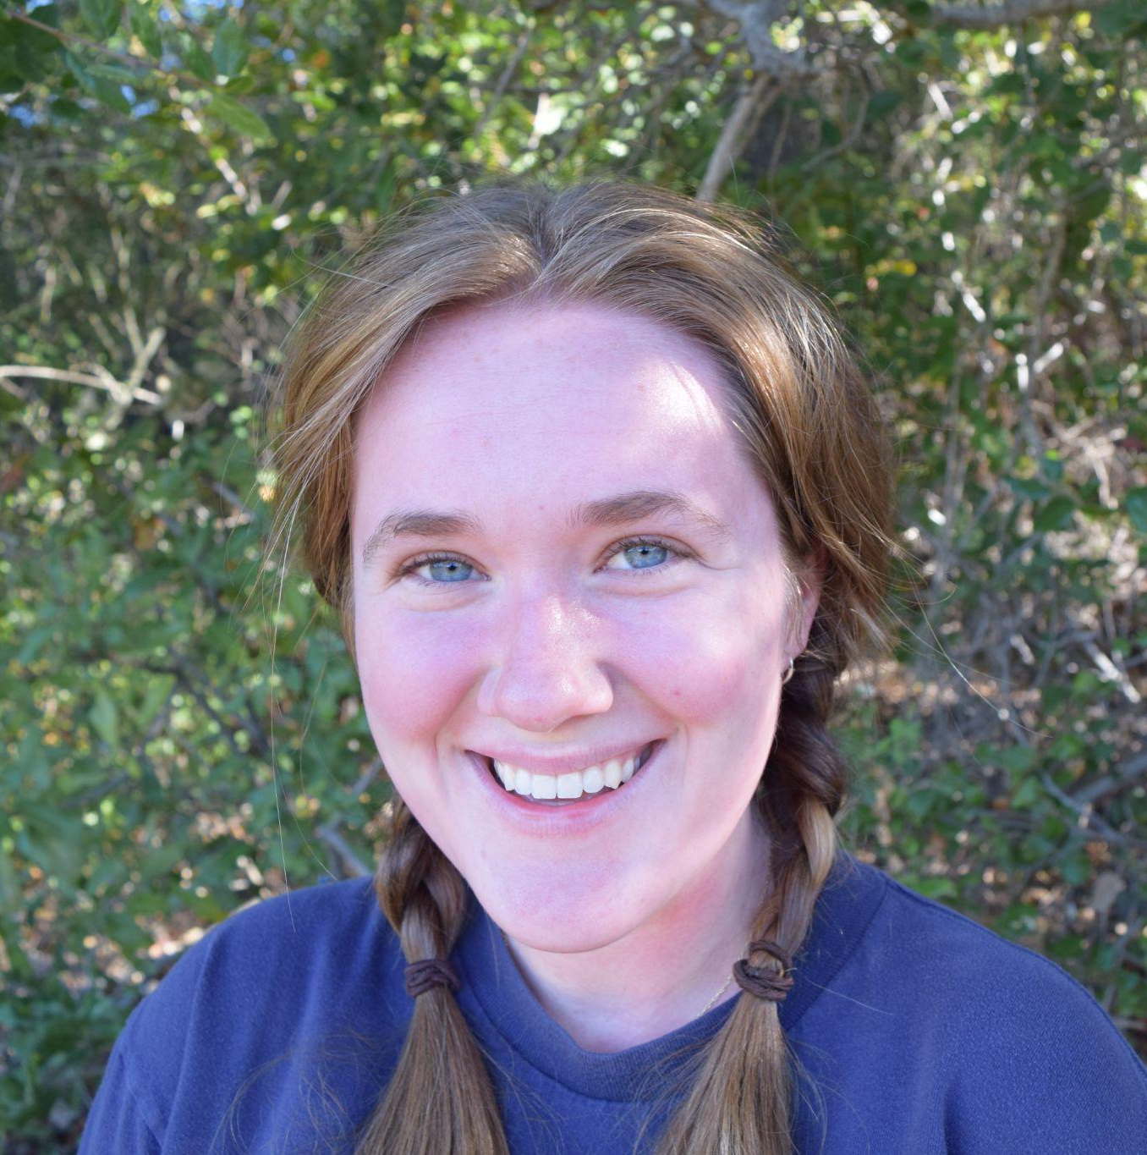
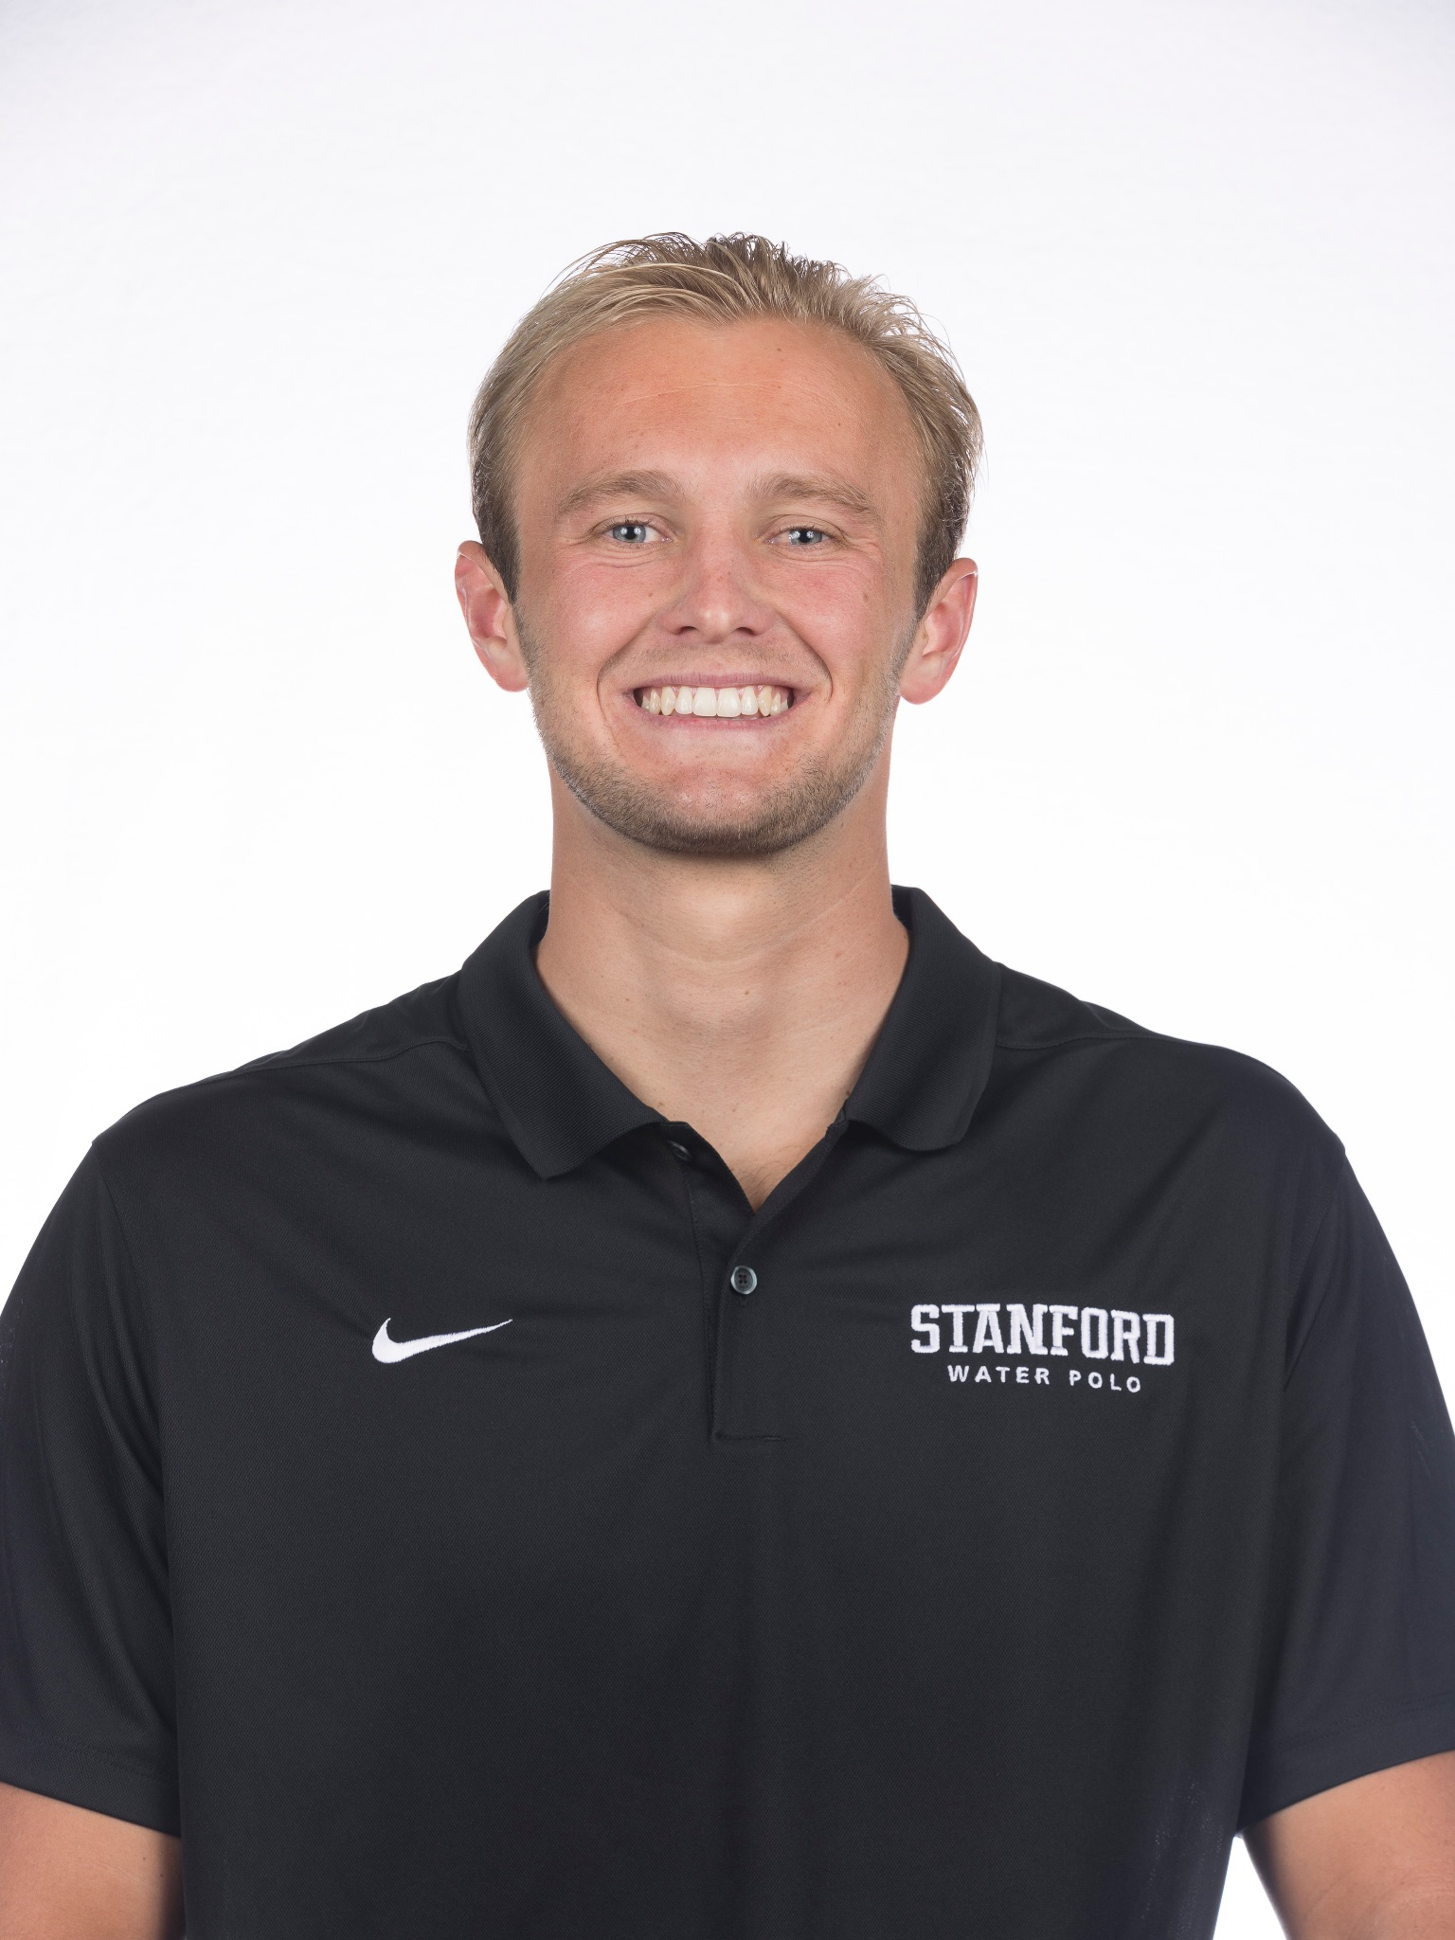
Our Team
CJ Indart
Ginelle Servat
Grace Miller
Riley Pittman

Slide 4
Revised Problem Domain
Old Project Domain - Concerns about post graduate life
NEW Project Domain - Support surrounding post-graduate job search

Slide 5
Additional Needfinding Results

Slide 6
Old Interviews
Sara
Alexandra
Needs… A way to find a fulfilling job and high quality of post-graduate life
Needs… The comfort of balance between her future and staying true to her passions
Emily
Trevor
Needs… A better way to connect with Stanford Athletes in the professional world
Needs… Adequate resources to secure satisfaction with chosen career path

Slide 7
Old Interviews
Sara
Alexandra
Needs… A way to find a fulfilling job and high quality of post-graduate life
Needs… The comfort of balance between her future and staying true to her passions
Emily
Trevor
Needs… A better way to connect with Stanford Athletes in the professional world
Needs… Adequate resources to secure satisfaction with chosen career path

Slide 8
Old Interviews
Sara
Alexandra
Support system around finding a job
Needs… A way to find a fulfilling job and high quality of post-graduate life
Needs… The comfort of balance between her future and staying true to her passions
Emily
Trevor
Needs… A better way to connect with Stanford Athletes in the professional world
Needs… Adequate resources to secure satisfaction with chosen career path

Slide 9
NEW Interviews
Sharon
Julia
Former Career Coach for Stanford CareerEd
Southern California
(Interviewed over Zoom)
Medical Device Sales for Boston Scientific
Seattle, WA
(Interviewed in-person)
Notes:
Julia conducted in person, friends with my sister and was visiting in SF
Sharon conducted in person??

Slide 10
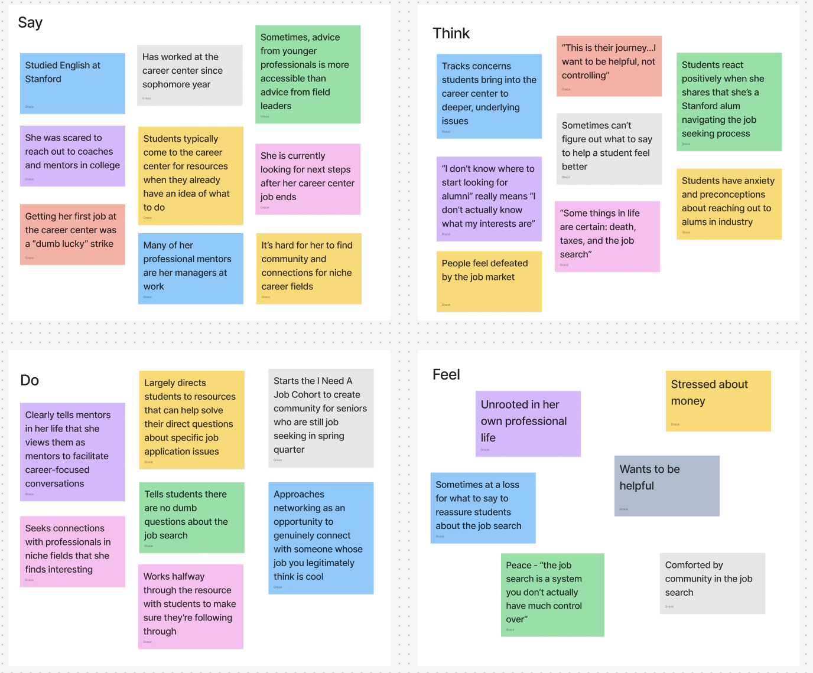
Sharon’s Empathy Map

Slide 11
Sharon’s Empathy Map
Young Stanford grad job searching while working as career counselor
It’s hard to give students (and herself) purpose if they don’t already have it
Focuses on networking and community building
Helpless against the forces of the job market

Slide 12
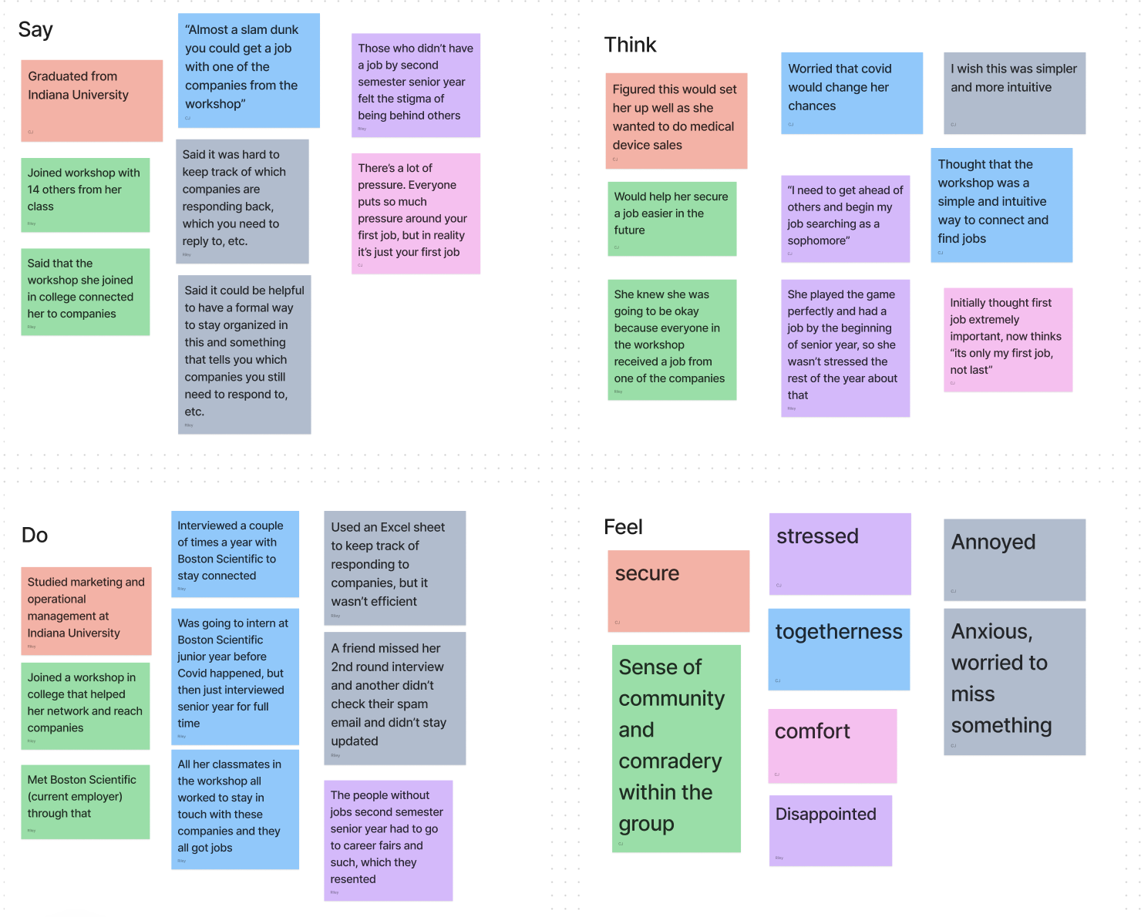
Julia’s Empathy Map

Slide 13
Julia’s Empathy Map
Hard to keep track of companies replying to you
Always felt confident b/c of her workshop experience, and it gave her a leg up
Actively stayed in touch with companies each year
Felt a large sense of community and security through workshop

Slide 14
Key Insights
Sharon
Julia
CareerEd gives resources for specific jobs, not guidance
Difficult to reassure students emotionally during the job process
Despite being a career coach, anxious and currently unemployed
Her workshop group proved extremely valuable
She missed an interview due to an over cluttered email box
Sense of community helped her job search

Slide 15
POVs | HMWs

Slide 16
Trevor: Old POV
We met…
  Trevor, a recently graduated behavioral therapist working in Menlo Park
We were surprised to notice…
  that despite already being out of college, Trevor was far more concerned about quality of life and whether he had an accurate gauge on what job was best for him than he was about getting hired
We wonder if this means…
  that Trevor feels disconnected from good information about career options and trajectory.
It would be game changing to…
  help Trevor create the lifestyle he wants.
Notes:
We met Trevor, a recently graduated behavioral therapist working in Menlo Park. We were surprised to realize that despite already being out of college, Trevor was far more concerned about quality of life and whether he had an accurate gauge on what job was best for him than he was about getting hired. We wondered if this means that Trevor feels disconnected from good information about career options and trajectory. It would be game-changing to help Trevor create the lifestyle he wants.

Slide 17
Julia: New POV #1
We met…
  Julia, an Indiana University graduate currently working for Boston Scientific in medical device sales.
We were surprised to notice…
  that she missed a second round interview because she missed the email in her inbox.
We wonder if this means…
  she felt overwhelmed by the amount of emails in her inbox.
It would be game changing if…
  people never had to worry about missing opportunities because of a cluttered inbox.

Slide 18
Julia POV #1: HMW
How might we redesign email notifications to capture the user’s attention?
How might we make email checking a habit?
How might we make checking emails more engaging?
Notes:
How might we automatically flag emails related to critical opportunities?
How might we make email inboxes less visually overwhelming?
How might we remind people of important emails?
How might we make mail checking a habit?
How might we make the interviewing process more predictable?
How might we make the job process not rely on emails?
How might we prioritize important emails in a user’s inbox?
How might we create a smarter system for filtering emails?
How might we redesign email notifications to capture the user’s attention?
How might we reliably auto-discard junk emails?
How might we make checking emails fun?

Slide 19
Julia: New POV #2
We met…
  an Indiana University graduate currently working her first job at Boston Scientific, which was offered to her through a workshop.
We were surprised to hear…
  that some of her friends felt isolated and behind in the post-graduate job search, Julia felt more supported due to the workshop
We wonder if this means…
  that community strongly influences confidence or anxiety in the job search.
It would be game changing to…
  create a way for students to feel connected and supported during the post-grad life

Slide 20
Julia POV #2: HMW
How might we make job applications a social activity?
How might we make students applying for jobs together feel like a team?
How might we encourage students to actively stay connected once they’ve met?
Notes:
How might we leverage workshops to foster a sense of community in the job search?
How might we make job applications a social activity?
How might we make the job application and search process enjoyable?
How might we make the job search not feel like a race?
How might we motivate students through the job search process?
How might we help students applying to jobs together feel like a team?
How might we use community to boost confidence?
How might we make workshops more common as pre-graduate professional training?
How might we create buzz surrounding referring one another to jobs/sharing opportunities?
How might we connect college students who are seeking similar jobs?
How might we create a network of unemployed college graduates?
How might we encourage students to actively stay connected once they’ve met?
How might encourage collaboration among students rather than competition?

Slide 21
Sharon: New POV #3
We met…
  We met Sharon, a 2021 Stanford graduate who recently left her two-year position as a career coach for Stanford CareerEd and is now job seeking.
We were surprised to notice…
  that despite working professionally in career services, Shannon still feels uncertain about what she should do with her own life and career.
We wonder if this means…
  that she’s worried the next step in her career won’t help her achieve her life goals.
It would be game changing to…
  help align professional goals with life goals.

Slide 22
Sharon POV: HMW
How might we help students identify their strengths and connect it with career paths?
How might we help students match their ideal lifestyle and income milestones to a career?
How might we help students share and learn from each other’s interests and journeys?
Notes:
How might we connect students with career professionals who are willing to give them advice in an approachable context?
How might we expose students to opportunities in niche career paths?
How might we show students a wider variety of options?
How might we connect students with professionals with whom they share things in common?
How might we help students identify their strengths and connect it with career paths?
How might we help students match their ideal lifestyle and income milestones to a career?
How might we help students share and learn from each other’s interests and journeys?
How might we create clearer avenues to self-employment?
How might we demystify the job market for new graduates?
How might we make sure people meet their life goals?

Slide 23
Solutions & Experience Prototypes

Slide 24
How might we make checking emails more engaging?
Solution: Create a continuous scroll for daily work emails
Assumption: Emails in this format will hold users’ attention
What we’ll do: Have people look at a normal email interface (Outlook, Apple Mail) and then have them compare it to the continuous scrolling way.
Ask them:
Which interface was more intriguing?
From which interface did you remember more content?
Could you see yourself clearing junk this way?

Slide 25
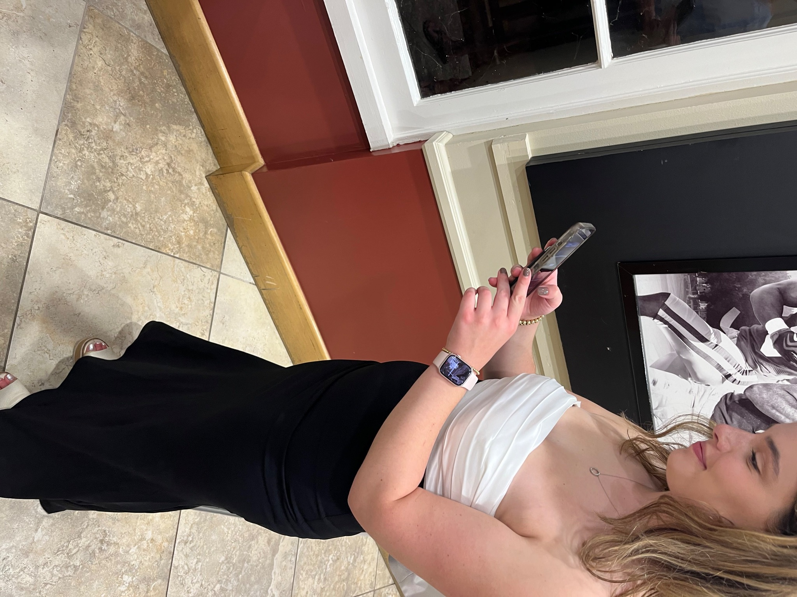
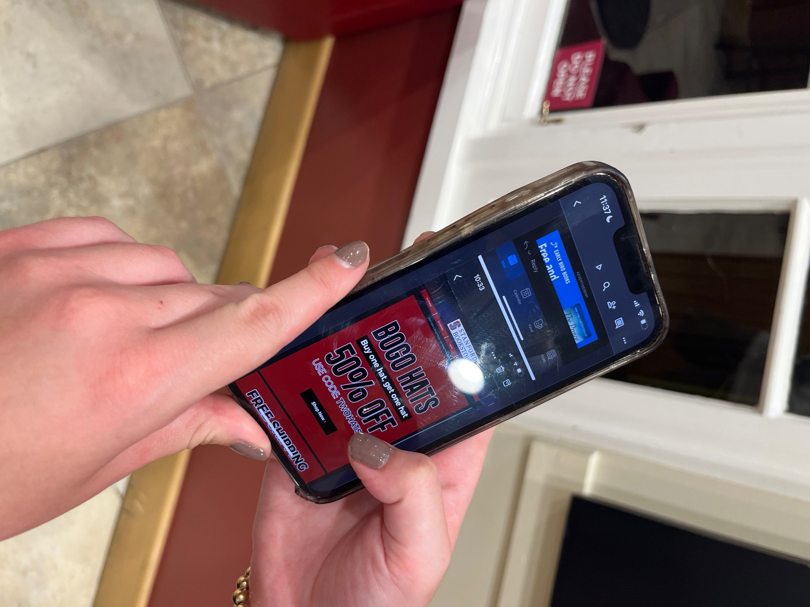

Slide 26
Experience Prototype #1 - Email Reels
Who participated?
Three randomly selected Stanford undergraduates at Old Union
They fit our product market – use email regularly
What worked?
Each person was was intrigued by the interface
Users could see themselves using it to clear their junk
Users remembered more specific information from the new interface
What didn’t work?
Users had to scroll within each reel to view the full email
Difficult to view inboxes with lots of emails
Main Takeaways
Users appreciate the new design
Users could see themselves using this
👥
✅
❌
⭐
⭐
✅
❌
👥
✅

Slide 27
How might we make students applying to jobs together feel like a team?
Solution: Create a dating-app style platform that matches students into pods of 5-10 students seeking similar careers
Assumptions: Students will want to collaborate instead of compete with their career matches
Test: Get two people looking for similar jobs and have them talk for 5 minutes, then ask them questions about their experience
Notes:
Novelty aspect: Non-professional social platform specifically for job seekers

Slide 28
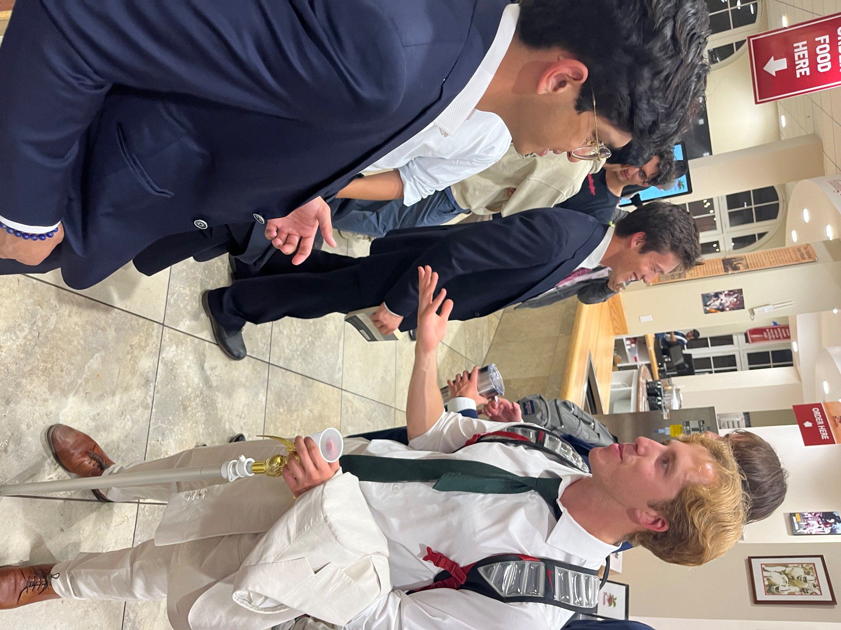
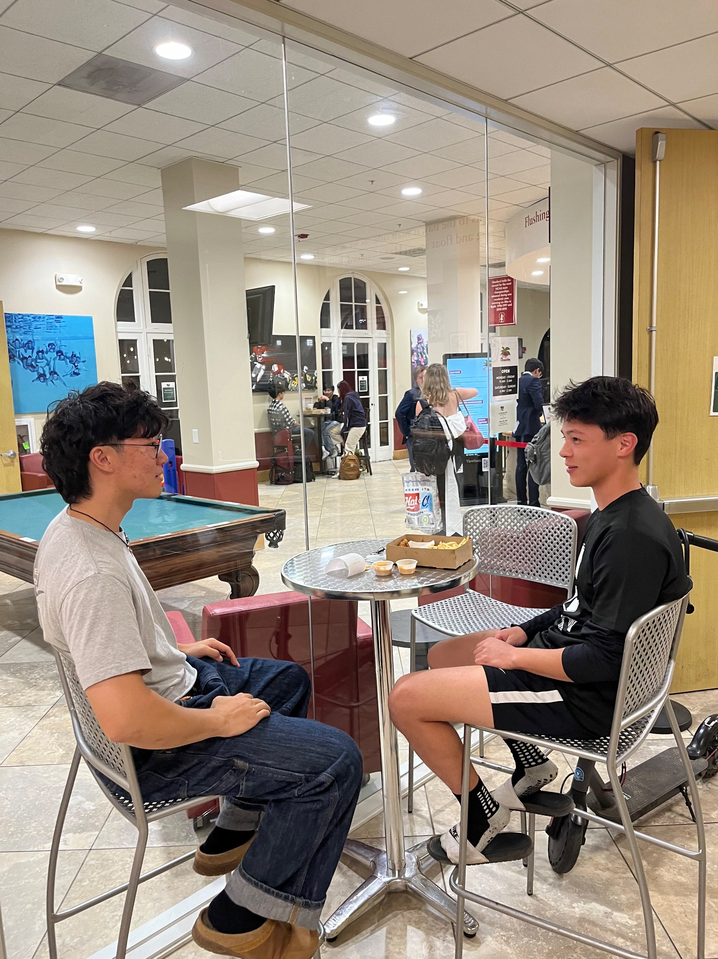

Slide 29
Experience Prototype #2 - Speed Dating
Who participated?
Four randomly recruited Stanford undergraduates at Old Union
They fit our product market – all were job searching
What worked?
Students felt more hopeful after conversations
One pair exchanged contact information
Mixing academic years (sophomore and senior) reduced competition
What didn’t work?
Conversations were initially awkward
The mixed-grade pair did not exchange contact information
Main Takeaways
Connecting with students job searching in a similar field raises morale
After one conversation, participants were willing to connect further
Mixing ages and demographics can reduce competition
👥
✅
❌
⭐
✅
❌
👥
⭐
✅
⭐

Slide 30
How might we help students match their ideal lifestyle and income milestones to a career?
Solution: Career database searchable by criteria important to the user
Assumptions: Students who don’t know what job they want post-college do know what lifestyle they want
Test: Google Form that asks about ideal lifestyles and if they know what career path they want
Notes:
NOVELTY:

Slide 31
Experience Prototype #3 - Career Database
Who participated?
Six randomly recruited Stanford undergraduates at Tresidder
What worked?
Most were unsure of their desired job title
Most want to align work with lifestyle preferences
What didn’t work?
Further testing should explore whether a database would provide students with attractive options
Main Takeaways
Students know the lifestyle they want, but not the career path
👥
✅
❌
⭐
✅

Slide 32
What’s Next?

Slide 33
Solutions Moving Forward
Email Reels
Speed Dating
Career Database

Slide 34
Solutions Moving Forward
Email Reels
Speed Dating
Career Database

Slide 35
Solutions Moving Forward
⭐
Addresses POVs and project domain
⭐
Community-building aspect aligned with well-being
⭐
Received overwhelmingly positive feedback
Notes:
Creates a way for students to feel connected and supported

Slide 36
Ethical Considerations
User Bias
Safety
Equal Access
Users may subconsciously swipe on teammates of similar background or demographics
Social media platforms are susceptible to harassment and abuse without good moderation
Ensure that everyone is matched into a group regardless of characteristics including class year, major, etc.

Slide 37
Thank you!

Slide 38
HMW Brainstorming
Julia #1
Julia #2
Sharon
How might we automatically flag emails related to critical opportunities?
How might we make email inboxes less visually overwhelming?
How might we remind people of important emails?
How might we make mail checking a habit?
How might we make the interviewing process more predictable?
How might we make the job process not rely on emails?
How might we prioritize important emails in a user’s inbox?
How might we create a smarter system for filtering emails?
How might we redesign email notifications to capture the user’s attention?
How might we reliably auto-discard junk emails?
How might we make checking emails fun?
How might we leverage workshops to foster a sense of community in the job search?
How might we make job applications a social activity?
How might we make the job application and search process enjoyable?
How might we make the job search not feel like a race?
How might we motivate students through the job search process?
How might we help students applying to jobs together feel like a team?
How might we use community to boost confidence?
How might we make workshops more common as pre-graduate professional training?
How might we create buzz surrounding referring one another to jobs/sharing opportunities?
How might we connect college students who are seeking similar jobs?
How might we create a network of unemployed college graduates?
How might we encourage students to actively stay connected once they’ve met?
How might encourage collaboration among students rather than competition?
How might we connect students with career professionals who are willing to give them advice in an approachable context?
How might we expose students to opportunities in niche career paths?
How might we show students a wider variety of options?
How might we connect students with professionals with whom they share things in common?
How might we help students identify their strengths and connect it with career paths?
How might we help students match their ideal lifestyle and income milestones to a career?
How might we help students share and learn from each other’s interests and journeys?
How might we create clearer avenues to self-employment?
How might we demystify the job market for new graduates?
How might we make sure people meet their life goals?

Slide 39
Solutions Brainstorming
How might we make checking emails fun?
How might we help students applying to jobs together feel like a team?
How might we help students match their ideal lifestyle and income milestones to a career?
Email bingo app
Email insights and analytics -- provide users with fun insights about their email habits (such as average response times)
UI plugin that makes inbox visually sleeker
Highly customizable email interface (like iphone widget)
AI filter to get rid of spam and mailing lists
Application that creates TikTok scroll for daily work email
Social networking app that lets your friends leave notes on your inbox
Email with intermittent rewards for checking
Accountability bot for emails that sends you reminders and gives you streaks for organizing your inbox
BeReal but for checking your email once a day (retains anonymity if we share screenshots)
Sound effects on various functions (like when you trash an email)
Gamifying the job search and turning it into a team-based challenge
Match students in the same academic field to encourage job searching together
Create a dating app-style platform that matches students into pods of 5-10 students seeking similar careers
Form accountability partners based on student personalities/not career interests
Platform for exchanging mock interviews with peers
Create a platform on which career professionals offer mentorship for pods of self-selected job applicants who are interested in their career field
Job application database with social media elements (connect with friends, share job opportunities, refer friends to job postings, reach milestones suggested by the app)
Workshops that connect students of similar interests and brings in companies in relevant fields
Group application progress tracker that lets students share their updates
Workshops or digital pods led by young career professionals who just got hired in a career field of interest
Virtual job search collaboration spaces, where students practice interviewing with each other, look over resumes, etc.
Create a platform on which niche industry professionals post profiles of their careers and offer mentorship
Career database searchable by criteria important to the user (salary, location, hours per week, with people vs. introverted, etc.)
Platform that demystifies the job market (explains industry trends and where/when to apply to get reliably hired)
Virtual job shadowing platform where professionals can post days in the life
Job of the day app that prompts with a niche job concept every day
Speaker of the day, 2 minute video given each morning with new speakers/careers
  Could provide what they do and way to reach out to them if interested
Providing access to speakers who are leaders in various industries
Opportunities for one-day (or really short-term) internships
Social media network to connect applicants with professionals willing to invite anyone to shadow for a day
Lifestyle to income translator to help students project required income for a desired lifestyle based on location, etc
CoolWorx platform for long-term niche careers, searchable by college degree

Slide 40
Additional Brainstorming
(Other forms and information in Team 2 folder
https://drive.google.com/drive/folders/1nqc_gqr4rZEGhyMVtIme7QTHSdsdC85E?usp=drive_link)

Slide 41
10/9
Sample povs - Julia
We met Julia, a college graduate currently working for Boston Scientific in medical device sales.
We were surprised to notice that she secured a full-time job offer early during her senior year from just one workshop, despite a lack of sales internship experience.
We wonder if this means there is more to job readiness than conventional work experience.
It would be game-changing to create welcoming environments for people of different work backgrounds and paths to professional success.
We met Julia, an Indiana University graduate currently working for Boston Scientific in medical device sales.
We were surprised to notice that she missed a second round interview because she missed the email in her inbox.
We wonder if this means she felt overwhelmed by the amount of emails in her inbox.
It would be game changing if people never had to worry about missing opportunities because of a cluttered inbox.
We met Julia, an Indiana University graduate currently working at her first job, at Boston Scientific.
We were surprised to notice that she initially thought her first job was a significant factor in her overall career, but she now sees it as just a step in the process.
We wonder if this implies college graduates often feel a pressure to find the “perfect” job straight out of college as a way to establish success.
It would be game-changing to inform of the different ways college graduates measures career success.
We met Julia, an Indiana University graduate currently working at her first job, at Boston Scientific, which was offered to her through a workshop
We were surprised to hear that some of her friends felt isolated and behind in the post-graduate job search, Julia felt more supported due to the workshop.
We wonder if this means that community strongly influences confidence in the job search.
It would be game-changing to create a way for students to feel connected and supported during the post-graduate job search.

Slide 42
10/9
Sample povs - Shannon
We met Shannon, a 2021 Stanford graduate who recently left her two-year position as a career coach for Stanford CareerEd and is now job seeking. We were surprised to notice that despite working professionally in career services, Shannon still feels uncertain about what she should do with her own life and career. We wonder if this means that there aren’t many actionable resources available to help students choose their career path, even through designated programs like Stanford’s career center. It would be game-changing to help students figure out what they want to do with their lives.
We met Shannon, a 2021 Stanford graduate who recently left her two-year position as a career coach for Stanford CareerEd and is now job seeking. We were surprised to notice that despite having many resources at her fingertips for helping students in the job search, Sharon still feels at a loss to help students feel cheerful about their prospects. We wonder if this means that one of the biggest issues students face during the job search is overcoming emotional barriers. It would be game-changing to dispel negative emotion surrounding the job search for new college graduates.
We met Shannon, a 2021 Stanford graduate who recently left her two-year position as a career coach for Stanford CareerEd and is now job seeking. We were surprised to notice that Shannon was the leader of one of Stanford’s only in-person community support groups for job-seeking seniors, which she personally founded. We wonder if this means that there isn’t much community surrounding the job search for soon-to-be college graduates. It would be game-changing to help job-seeking college seniors feel less alone.

Slide 43
Good POVs
We met Julia, an Indiana University graduate currently working for Boston Scientific in medical device sales.
We were surprised to notice that she missed a second round interview because she missed the email in her inbox.
We wonder if this means she felt overwhelmed by the amount of emails in her inbox.
It would be game changing if people never had to worry about missing opportunities because of a cluttered inbox.
We met Julia, an Indiana University graduate currently working her first job at Boston Scientific, which was offered to her through a workshop
We were surprised to hear that some of her friends felt isolated and behind in the post-graduate job search, Julia felt more supported due to the workshop.
We wonder if this means that community strongly influences confidence or anxiety in the job search.
It would be game-changing to create a way for students to feel connected and supported during the post-graduate job search.
We met Shannon, a 2021 Stanford graduate who recently left her two-year position as a career coach for Stanford CareerEd and is now job seeking. We were surprised to notice that despite working professionally in career services, Shannon still feels uncertain about what she should do with her own life and career. We wonder if this means that she’s worried the next step in her career won’t help her achieve her life goals. It would be game-changing to help align professional goals with life goals.

Slide 44
HMWs - first POV
How might we automatically flag emails related to critical opportunities?
How might we make email inboxes less visually overwhelming?
How might we remind people of important emails?
How might we make mail checking a habit?
How might we make the interviewing process more predictable?
How might we make the job process not rely on emails?
How might we prioritize important emails in a user’s inbox?
How might we create a smarter system for filtering emails?
How might we redesign email notifications to capture the user’s attention?
How might we reliably auto-discard junk emails?
How might we make checking emails fun?

Slide 45
HMWs - second POV
How might we leverage workshops to foster a sense of community in the job search?
How might we make job applications a social activity?
How might we make the job application and search process enjoyable?
How might we make the job search not feel like a race?
How might we motivate students through the job search process?
How might we help students applying to jobs together feel like a team?
How might we use community to boost confidence?
How might we make workshops more common as pre-graduate professional training?
How might we create buzz surrounding referring one another to jobs/sharing opportunities?
How might we connect college students who are seeking similar jobs?
How might we create a network of unemployed college graduates?
How might we encourage students to actively stay connected once they’ve met?
How might encourage collaboration among students rather than competition?

Slide 46
HMWs - third POV
How might we connect students with career professionals who are willing to give them advice in an approachable context?
How might we expose students to opportunities in niche career paths?
How might we show students a wider variety of options?
How might we connect students with professionals with whom they share things in common?
How might we help students identify their strengths and connect it with career paths?
How might we help students match their ideal lifestyle and income milestones to a career?
How might we help students share and learn from each other’s interests and journeys?
How might we create clearer avenues to self-employment?
How might we demystify the job market for new graduates?
How might we make sure people meet their life goals?

Slide 47
Solutions - How might we make checking emails fun?
Email bingo app
Email insights and analytics -- provide users with fun insights about their email habits (such as average response times)
UI plugin that makes inbox visually sleeker
Highly customizable email interface (like iphone widget)
AI filter to get rid of spam and mailing lists
Application that creates tiktok scroll for daily work email
Social networking app that lets your friends leave notes on your inbox
Email with intermittent rewards for checking
Accountability bot for emails that sends you reminders and gives you streaks for organizing your inbox
BeReal but for checking your email once a day (retains anonymity if we share screenshots)
Sound effects on various functions (like when you trash an email)

Slide 48
Solutions - How might we make students applying to jobs together feel like a team?
Gamifying the job search and turning it into a team-based challenge
Match students in the same academic field to encourage job searching together
Create a dating app-style platform that matches students into pods of 5-10 students seeking similar careers
Form accountability partners based on student personalities/not career interests
Platform for exchanging mock interviews with peers
Create a platform on which career professionals offer mentorship for pods of self-selected job applicants who are interested in their career field
Job application database with social media elements (connect with friends, share job opportunities, refer friends to job postings, reach milestones suggested by the app)
Workshops that connect students of similar interests and brings in companies in relevant fields
Group application progress tracker that lets students share their updates
Workshops or digital pods led by young career professionals who just got hired in a career field of interest
Virtual job search collaboration spaces, where students practice interviewing with each other, look over resumes, etc.

Slide 49
Solutions - How might we help students match their ideal lifestyle and income to a career?
Create a platform on which niche industry professionals post profiles of their careers and offer mentorship
Career database searchable by criteria important to the user (salary, location, hours per week, with people vs. introverted, etc.)
Platform that demystifies the job market (explains industry trends and where/when to apply to get reliably hired)
Virtual job shadowing platform where professionals can post days in the life
Job of the day app that prompts with a niche job concept every day
Speaker of the day, 2 minute video given each morning with new speakers/careers
  Could provide what they do and way to reach out to them if interested
Providing access to speakers who are leaders in various industries
Opportunities for one-day (or really short-term) internships
Social media network to connect applicants with professionals willing to invite anyone to shadow for a day
Lifestyle to income translator to help students project required income for a desired lifestyle based on location, etc
CoolWorx platform for long-term niche careers, searchable by college degree

Slide 50
Top 3 Solutions
Application that creates tiktok scroll for daily work email
  Critical Assumption:
    Emails presented in this format will hold users’ attention
  Test:
    Go up to a few people and show them normal email interaction, and then have them compare it with the scrolling way -- ask them questions after: which was more interesting? What content did you see in each? Stuff like this
Career database searchable by criteria important to the user (salary, location, hours per week, with people vs. introverted, etc.)
  Critical assumption:
    Students who don’t know what job they want post-college do know what lifestyle they want (income, location, etc.)
  Test:
    Google form that asks what job they want and questions about their lifestyle preferences
Create a dating app-style platform that matches students into pods of 5-10 students seeking similar careers
  Critical Assumption:
    Students will want to collaborate instead of compete with their career matches
  Test:
    find 2 people looking for similar jobs and have them talk for 5 min, then ask them questions
BeReal but for checking your email once a day
  Critical assumptions:
    Users are okay with sharing an aspect about their inbox

Slide 51
Create a dating app-style platform that matches students into pods of 5-10 students seeking similar careers
Questions for them after they talk:
Do you feel more or less hopeful about the job search?
Would you want to do that again?
Would you feel more compelled to help each other or compete if you continued connecting?

Slide 52
Application that creates tiktok scroll for daily work email
Questions for them after they do the experience:
Which interface was more intriguing?
  Tiktok one -- it’s newer
  Similar
  Tiktok
From which interface do you feel like you remember more content?
  Normal one (because you individually click each one)
  Tiktok
  Titles - first, other - tiktok
Which interface is it easier for you to clear your junk (with swiping feature)?
  Tiktok one
  Tiktok
  Tiktok, but both
Could you see yourself clearing your inbox this way?
  Yes
  Yes
  Depends on inbox - yes for personal, but maybe no for work b/c it’s too many

Slide 53
Google form
Career database searchable by criteria important to the user (salary, location, hours per week, with people vs. introverted, etc.)
“What salary would you be truly content with?”

